Slide 1
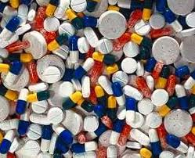
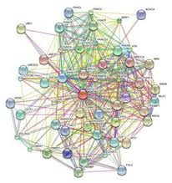
Screening for Novel Drug Combinations
Translational Interest
Basic Interest
Increased efficacy
Delay resistance
Attenuate toxicity
Inform signaling pathway connectivity
Identify synthetic lethality
Highlight polypharmacology
Notes:
Standards of care for many diseases are now drug combinations
A collection of small molecules with defined cellular mechanism
Solve technical challenges in compound plating and automated data analysis & visualization
Clinical relevance is a priority

Slide 2
How to Test Combinations
Many procedures described in the literature
Fixed dose ratio (aka ray)
Ray contour
Checkerboard
Genetic algorithm

Slide 3
When are Combinations Similar?
Differences and their aggregates such as RMSD can lead to degeneracy
Instead we’re interested in the shape of the surface
How to characterize shape?
Parametrized fits
Distribution of responses
Notes:
An alternative approach would be to fit the surface to a polynomial and then define similarity in terms of the parameter vector16

Slide 4
Similarity via the KS Test
Quantify distance between response distributions via KS test
If p-value > 0.05, we assume distance is 0
But ignores the spatial distribution of the responses on the concentration grid
Notes:
Ignoring spatial distribution leads to degeneracy

Slide 5
Similarity via the Syrjala Test
Syrjala test used to compare population distributions over a spatial grid
Invariant to grid orientation
Provides an empirical p-value
Less degenerate than just considering 1D distributions
Syrjala, S.E., “A Statistical Test for a Difference between the Spatial Distributions of Two Populations”, Ecology, 1996, 77(1), 75-80
Notes:
Lehar and the Combinatorx team have shown that specific target connectivities lead to response surfaces with specific forms
It is not unreasonable to assume that similar response surfaces might indicate similarity in the underlying connectivity
But of course, similar response surfaces can arise from multiple different connectivities

Slide 6
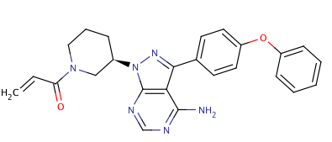
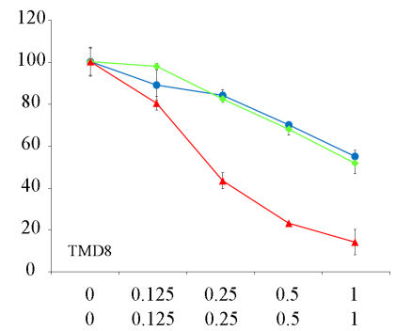
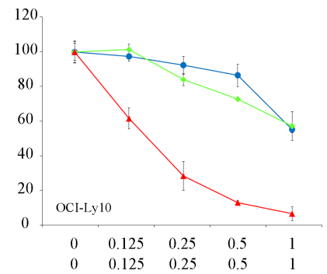
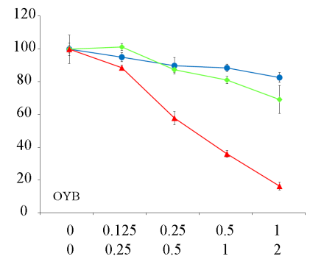
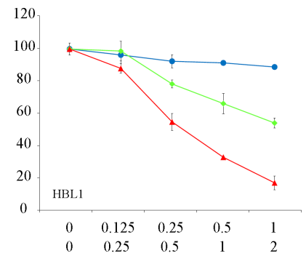
Ibrutinib Combinations For DLBCL
Primary focus is on investigating combinations with Ibrutinib for treatment of DLBCL
Btk inhibitor in Phase II trials
Experiments run in the TMD8 cell line, testing for cell viability
Viable
Cells
(% DMSO)
Ibrutinib
MK-2206
Ibrutinib* +
MK-2206
Ibrutinib* (nM)
MK-2206 (μM)
Mathews-Griner, Guha, Shinn et al. PNAS, 2014, in press
Notes:
(Activated b cell like) Diffuse large b cell lymphoma
Screening identified synergism with cmpds targeting PI3K (BKM-120), AKT (MK-206) and mTOR (everolimux) pathways

Slide 7
Clustering Response Surfaces
C1 (24)
C3(35)
C2(47)
C4(24)
Notes:
Given a distance matrix, we can now cluster combination responses
Interested in observing whether similarly shaped response surfaces are related to similar targets & pathways

Slide 8
Cluster C3
Vargatef, vorinostat, flavopiridol, …
Not particularly specific given the range of primary targets
Notes:
35 compounds
Vargatef, Vorinostat, flavopiridol, neratinib …
Similar GOBP enrichments to C2 not too surprising

Slide 9
Cluster C4
Focus on sugar metabolism
Ruboxistaurin, cycloheximide, 2-methoxyestradiol, …
PI3K/Akt/mTOR signalling pathways
Notes:
GO enrichments via compound targets is rough – lots of off target effects and these off target effects can be the driver in a combination response (vargatef example)

Slide 10
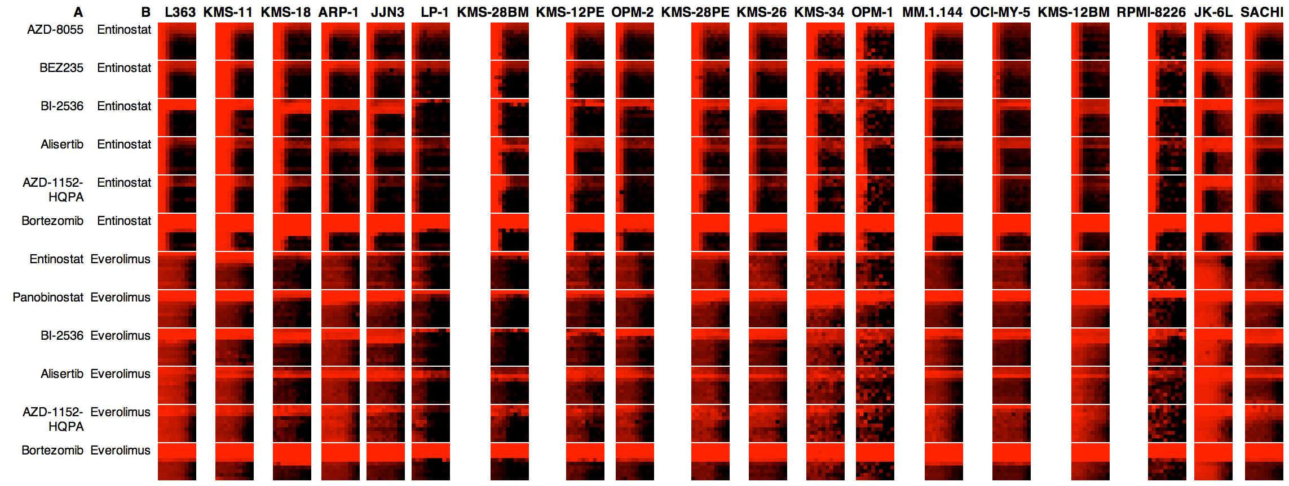
Combinations across Cell Lines
Cellular background affects responses
Can we group cell lines based on combination response?
Or find “fingerprints” that characterize cell lines?

Slide 11
Working in Combination Space
Each cell line is represented as a vector of response matrices
“Distance” between two cell lines is a function of the distance between component response matrices
F can be min, max, mean, …
L₁
L₂
,
= d₁
,
= d₂
,
= d₃
,
= d₄
,
= d₅

Slide 12
Many Choices to Make

